Slide 1

GROUNDWATER INTELLIGENCE
AI-POWERED MONITORING, ANOMALY DETECTION & DEPLETION FORECASTING
Powered by:
EXASOL | Python | DBeaver | Excel | PowerShell
Team:ASAP
GSSS Institute of Engineering and Technology for Women

Slide 2
THE PROBLEM: INDIA’S GROUNDWATER CRISIS
The Problem
India depends heavily on groundwater for agriculture, drinking water and livelihoods. Continuous depletion can push regions into Critical or Over-Exploited conditions.
What Already Exists
Thousands of Digital Water Level Recorders (DWLRs) monitor groundwater levels.
India-WRIS provides water-resource information.
CGWB assesses groundwater conditions and classifies assessment units.
Our Goal
Transform groundwater data into predictive, actionable intelligence before depletion becomes a crisis.

Slide 3
THE DATA EXISTS. THE INTELLIGENCE GAP DOESN’T HAVE TO.
Existing Ecosystem
DWLR Sensors
↓
Groundwater observations
↓
India-WRIS / Water-Resource Data
↓
Monitoring & Reporting
Current limitation:
Current approach
Record water levels
Observe anomalies
Identify current depletion
React after crisis
Our required approach
Interpret trends
Detect sensor faults
Forecast future risks
Enable early action
Our Core Insight
The challenge is not lack of data.
It is the lack of an integrated system that converts:
DATA → CLEAN DATA → PATTERNS → FORECAST → RISK → EARLY WARNING
Our Proposition
Build an AI-powered intelligence layer on existing groundwater monitoring infrastructure.

Slide 4
OUR PROPOSED SOLUTION
AI-Powered Groundwater Intelligence Platform
1. DATA INGESTION
DWLR observations
Historical groundwater levels
Rainfall data
Seasonal patterns
Station / block / district information
2. DATA PREPARATION
Cleaning → Missing-value handling → Standardization → Quality checks
3. INTELLIGENCE ENGINE
Anomaly Detection
Identify suspicious sensor readings
Trend Analysis
Identify persistent groundwater decline
Forecasting
Predict future groundwater conditions
4. RISK CLASSIFICATION
Normal → Watch → High Risk → Critical
5. ACTIONABLE DASHBOARD
Current condition
Historical trend
Forecast
Risk score
Sensor status
Early-warning alerts

Slide 5
DATA & TECHNOLOGY STACK
How We Built the Project
DATA SOURCES
CGWB
Groundwater assessments
Groundwater classification
Monitoring information
India-WRIS / NWIC
Water-resource and groundwater information
Rainfall & Seasonal Data
Supporting variables for trend and forecasting analysis
OUR TECHNOLOGY WORKFLOW
EXCEL
Data inspection & initial preparation
↓
DBEAVER
Database connection, SQL queries & data management
↓
EXASOL
High-performance analytics & large-scale processing
↓
PYCHARM
Python development & AI/ML workflow
↓
POWERSHELL
Terminal-based execution & project workflow

Slide 6
THE INTELLIGENCE ENGINE - DETECT → UNDERSTAND → PREDICT
1. SENSOR ANOMALY DETECTION
The system analyses:
Historical station behaviour
Sudden level changes
Missing/inconsistent observations
Temporal patterns
Output:
Normal Reading / Potential Sensor Anomaly
2. GROUNDWATER TREND ANALYSIS
Identifies:
Persistent water-level decline
Rate of decline
Seasonal variations
Changes from historical behaviour
Temporary fluctuation ≠ Long-term depletion
3. DEPLETION FORECASTING
Historical Levels + Seasonality + Rainfall + Trends
↓
Forecast Model
↓
Future Groundwater Condition
↓
Risk Level
Normal | Watch | High | Critical

Slide 7
FROM AI OUTPUT TO EARLY ACTION
GROUNDWATER INTELLIGENCE DASHBOARD
Dashboard Indicators
CURRENT STATUS
Current groundwater level
Latest reliable observation
Station status
TREND
Rising / Stable / Declining
Rate of change
DATA QUALITY
Normal
Suspicious
Potential anomaly
FORECAST
Future groundwater trend
Predicted risk
ALERT
Areas approaching critical thresholds
WHO BENEFITS?
District Authorities
Identify high-risk blocks
Prioritize interventions
Water-Resource Departments
Regional planning
Resource management
Farmers
Understand local groundwater stress
Receive simplified risk information
DECISION LOOP
SENSORS → DATA → EXASOL → AI → RISK SCORE → DASHBOARD → EARLY ACTION

Slide 8
IMPACT, SCALABILITY & FUTURE
Building a Predictive Groundwater Ecosystem
KEY IMPACT
Earlier Detection
Identify emerging depletion sooner.
Reliable Data
Flag faulty or suspicious sensor readings.
Risk-Based Planning
Focus resources on high-risk regions.
Scalable Analytics
Analyse large monitoring networks using Exasol.
Better Decisions
Convert raw data into forecasts, risk scores and alerts.
SCALABILITY
Pilot Districts
Regional Deployment
National Groundwater Intelligence Network
FUTURE DATA INTEGRATION
More DWLR stations
Rainfall
Soil & land-use information
Agricultural water demand
Recharge & extraction data
Additional environmental variables
DEPLOYMENT POTENTIAL
Government → Decision-support platform
Water Organizations → Risk analytics & planning
Farmers → Localized groundwater alerts

Slide 9
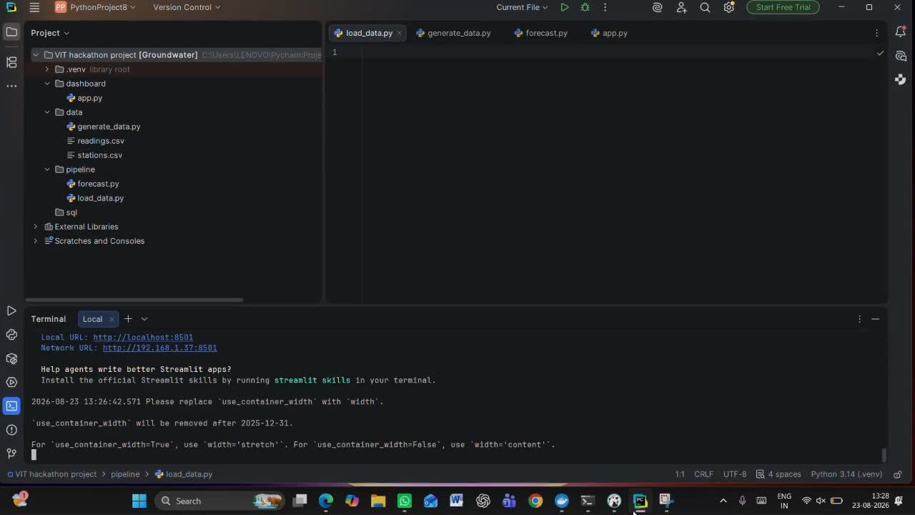

Slide 10
THANK YOU

